Slide 1
A Tour of the Kingdom
Luke 17:11-21

Slide 2
A Tour of the Kingdom
“²⁰ Once, on being asked by the Pharisees when the kingdom of God would come, Jesus replied, ‘The coming of the kingdom of God is not something that can be observed, ²¹ nor will people say, ‘Here it is,’ or ‘There it is,’ because the kingdom of God is in your midst.’”(Lk. 17:20-21)

Slide 3
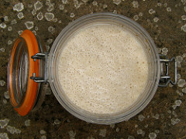
The Mustard Seed and Leaven
Matthew 13:31-32
Matthew 13:33
Notes:
Insert a map of your country.

Slide 4
Kingdom Growth
“⁵ These twelve Jesus sent out with the following instructions: “Do not go among the Gentiles or enter any town of the Samaritans. ⁶ Go rather to the lost sheep of Israel. ⁷ As you go, proclaim this message: ‘The kingdom of heaven has come near.’ ⁸ Heal the sick, raise the dead, cleanse those who have leprosy, drive out demons. Freely you have received; freely give.” (Mt. 10:5-8)

Slide 5
Righteousness
“² Praise the Lord, my soul, and forget not all his benefits— ³ who forgives all your sins and heals all your diseases…
⁶ The Lord works righteousness and justice for all the oppressed.”
(Psa. 103:2-3,6)

Slide 6
Righteousness
“Of the greatness of his government and peace there will be no end. He will reign on David’s throne and over his kingdom, establishing and upholding it with justice and righteousness from that time on and forever. The zeal of the Lord Almighty will accomplish this.” (Isa. 9:7)

Slide 7
Righteousness
“Blessed are those who are persecuted because of righteousness, for theirs is the kingdom of heaven.” (Mt. 5:10)
“¹⁹ Therefore anyone who sets aside one of the least of these commands and teaches others accordingly will be called least in the kingdom of heaven, but whoever practices and teaches these commands will be called great in the kingdom of heaven. ²⁰ For I tell you that unless your righteousness surpasses that of the Pharisees and the teachers of the law, you will certainly not enter the kingdom of heaven.” (Mt. 5:19-20)

Slide 8
Righteousness
“Blessed are those who are persecuted because of righteousness, for theirs is the kingdom of heaven.” (Mt. 5:10)
“¹⁹ Therefore anyone who sets aside one of the least of these commands and teaches others accordingly will be called least in the kingdom of heaven, but whoever practices and teaches these commands will be called great in the kingdom of heaven. ²⁰ For I tell you that unless your righteousness surpasses that of the Pharisees and the teachers of the law, you will certainly not enter the kingdom of heaven.” (Mt. 5:19-20)

Slide 9
Righteousness
“^{10 ’}What should we do then?’ the crowd asked.
¹¹ John answered, ‘Anyone who has two shirts should share with the one who has none, and anyone who has food should do the same.’
¹² Even tax collectors came to be baptized. ‘Teacher,’ they asked, ‘what should we do?’
¹³ ’Don’t collect any more than you are required to,’ he told them.
¹⁴ Then some soldiers asked him, ‘And what should we do?’
He replied, ‘Don’t extort money and don’t accuse people falsely—be content with your pay.’” (Lk. 3:10-14)

Slide 10
Righteousness
“³³ But seek first His kingdom and His righteousness, and all these things will be given to you as well.”
(Mt. 6:33)

Slide 11
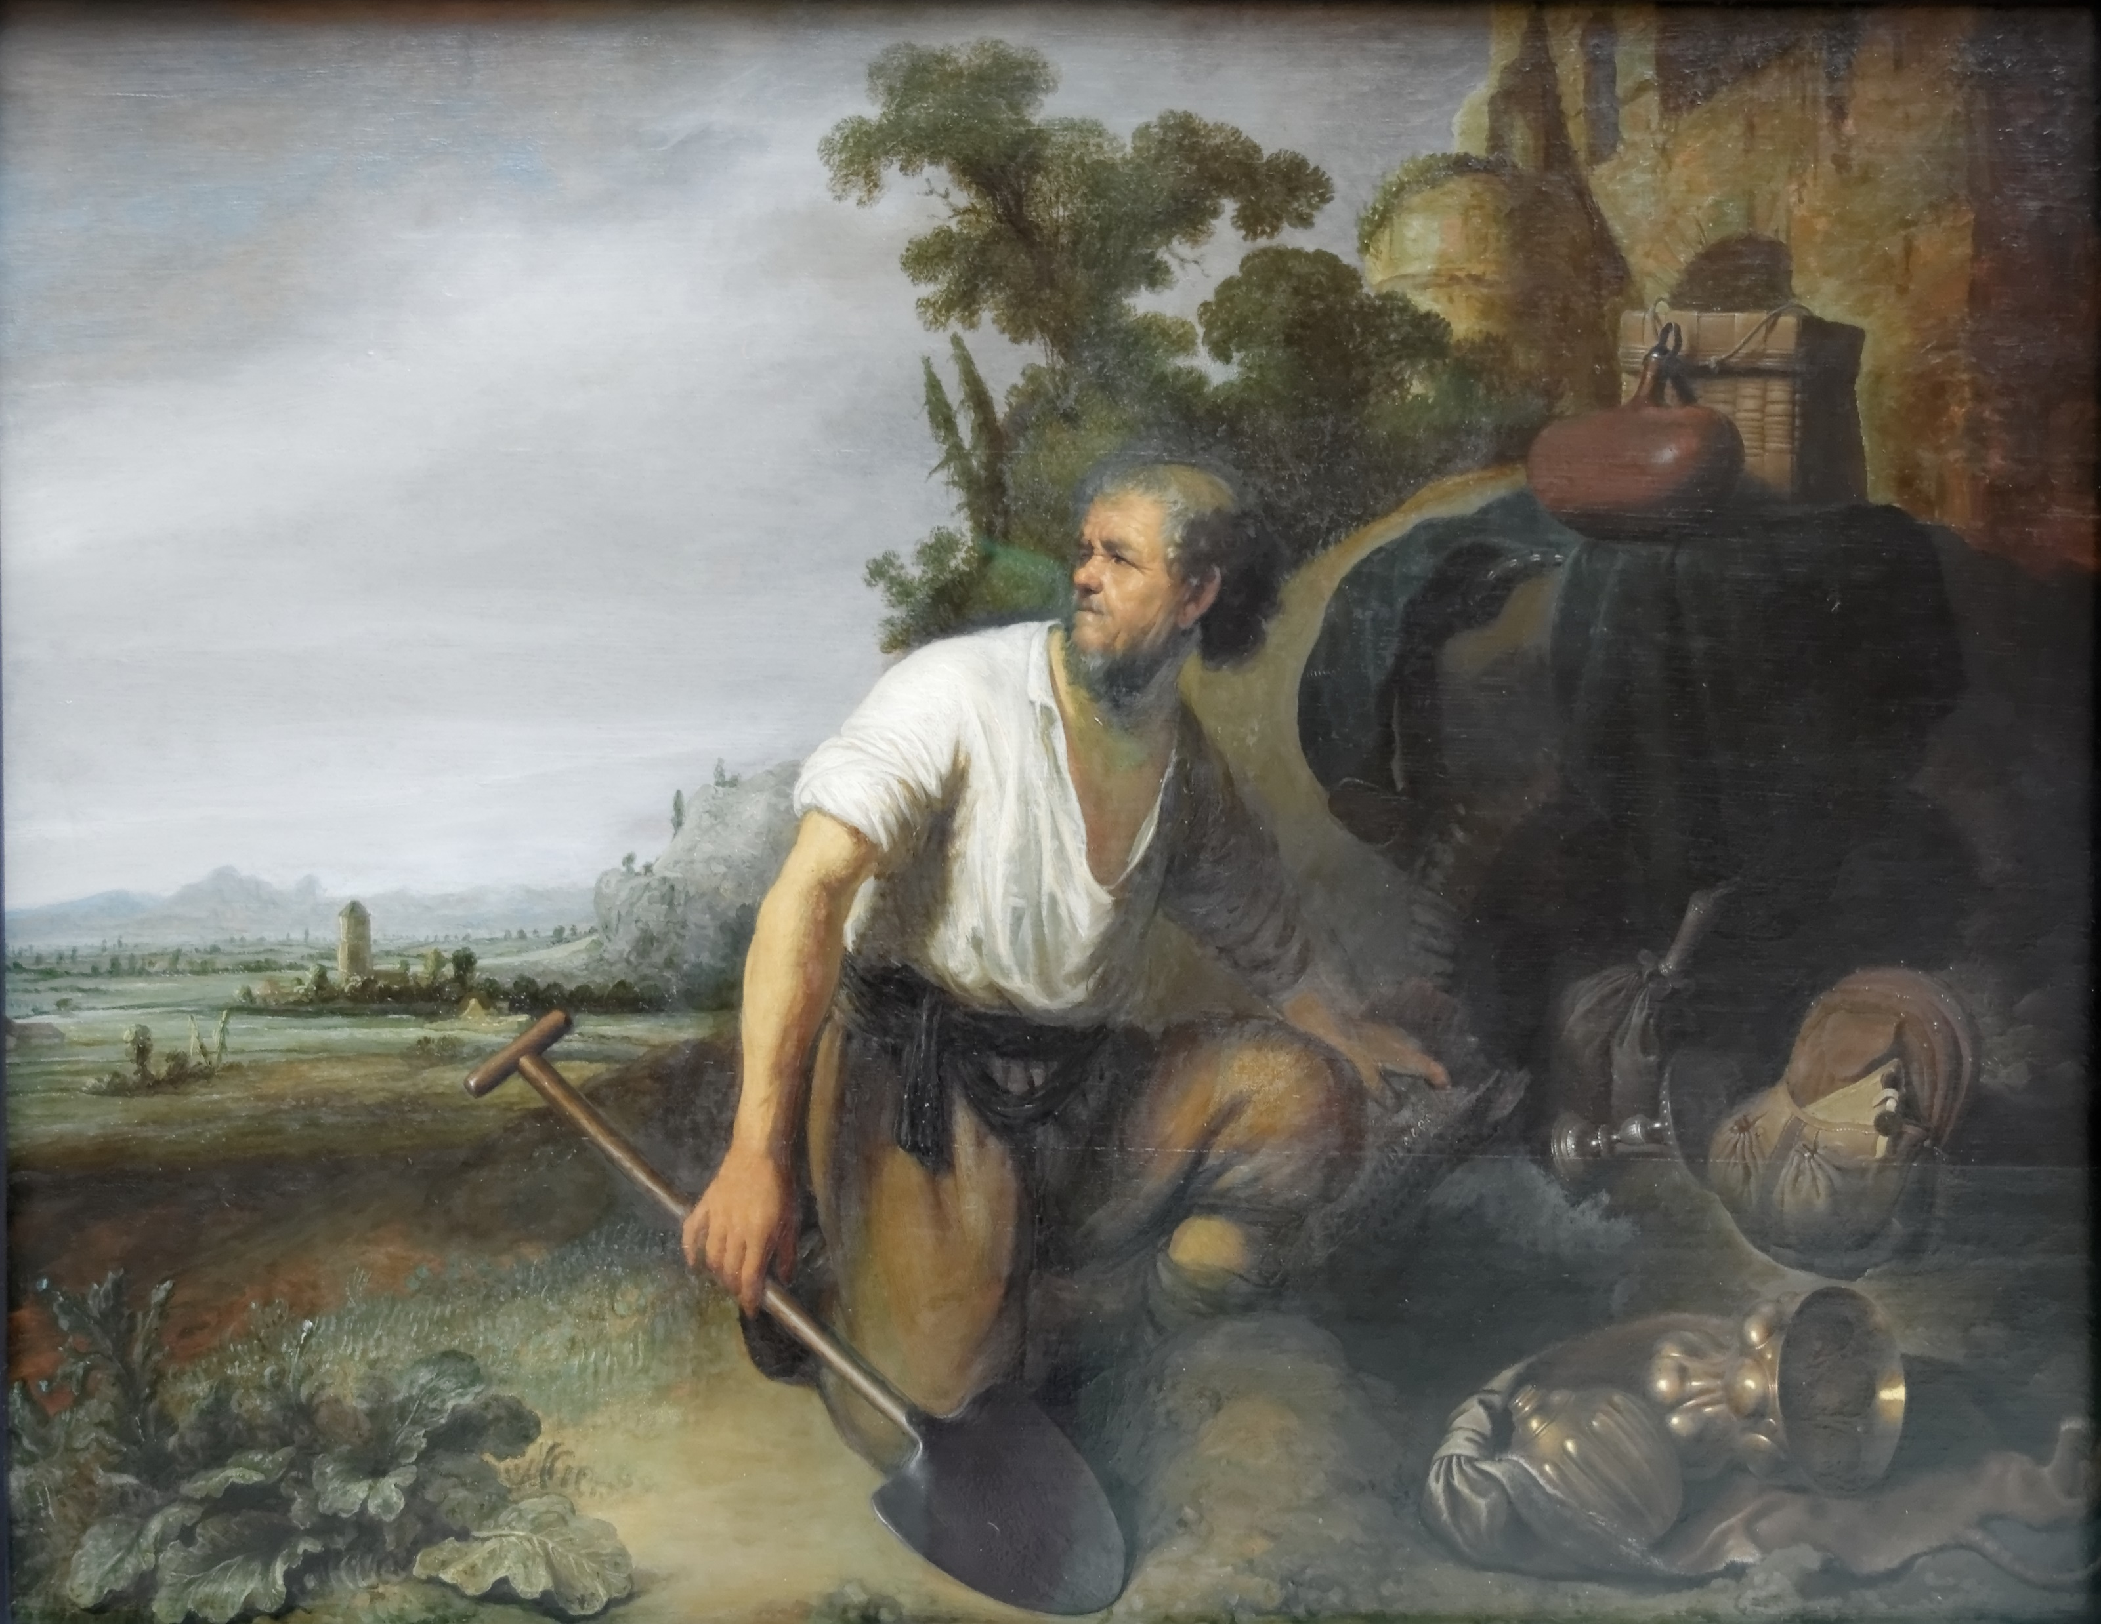
The Hidden Treasure and the Pearl
Matthew 13:44
Matthew 13:45-46
Notes:
Insert a map of your country.

Slide 12
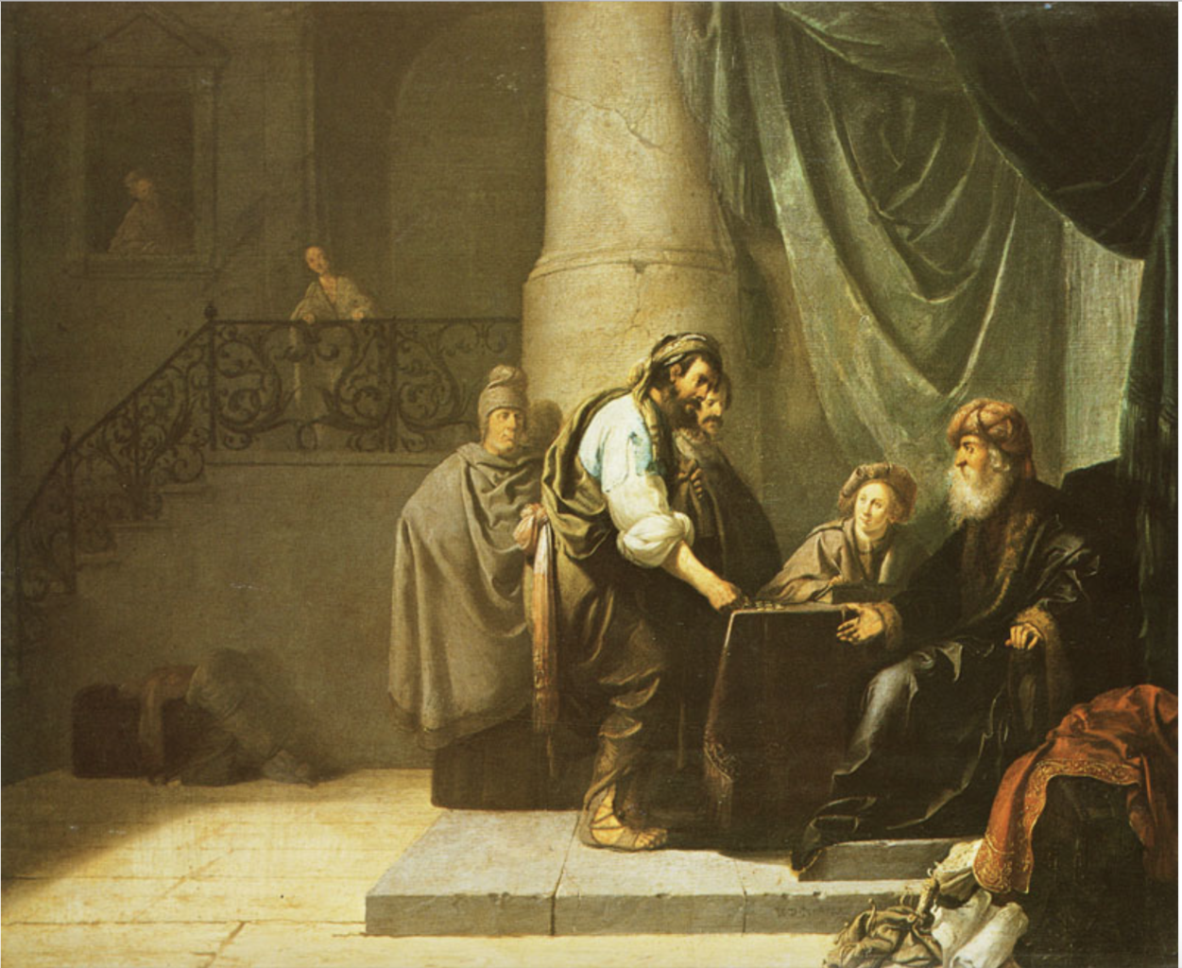
The Parable of the Talents

Slide 13
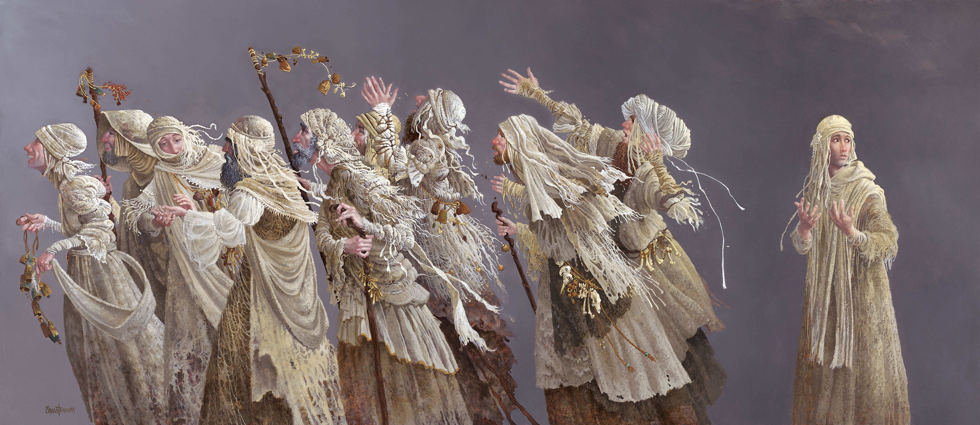
The Ten Lepers

